Slide 1

Data Quality Monitoring System for Real-World Taxi Trips Model
By: Aashritha Aachi
netID: aa3333
This project implements an automated pipeline for profiling, cleaning, and analyzing the NYC Yellow Taxi 2024 Aggregated Dataset. The system integrates database storage, data profiling, cleaning, and machine learning–based anomaly detection to assess and monitor data quality end-to-end.

Slide 2
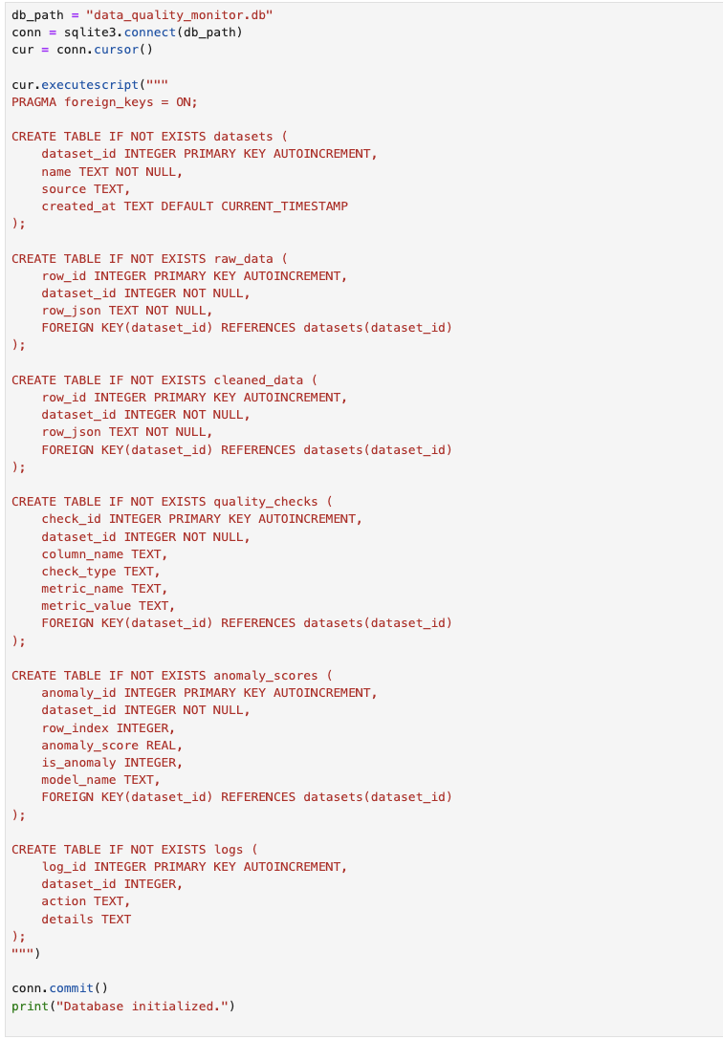
SQLite Schema Database Setup
This code initialized the SQLite database and creates a structured schema to store every part of the data quality pipeline. Six tables are defined, capturing raw data, cleaned data, profiling metrics, anomalies, dataset metadata, and pipeline logs. This enables traceability of professional data pipelines where each stage must be recorded.

Slide 3

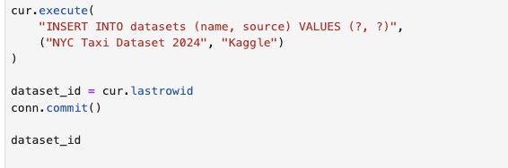
Loading and Registering the Dataset
The NYC Yellow Taxi Dataset is loaded into a DataFrame, and the first few rows are displayed to confirm correct import. The dataset is then registered in the database, which assigns a unique dataset_id used to link all raw rows, cleaned rows, anomaly records, and profiling entries to this dataset.

Slide 4
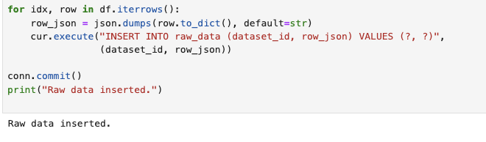
Inserting Raw Data into the Database
Each row of the dataset is converted to JSON and inserted into the raw_data table. This preserves the exact original data before any cleaning or modification. Storing raw data ensures that the full pipeline is transparent, and allows later debugging by comparing cleaned records against their original forms.

Slide 5
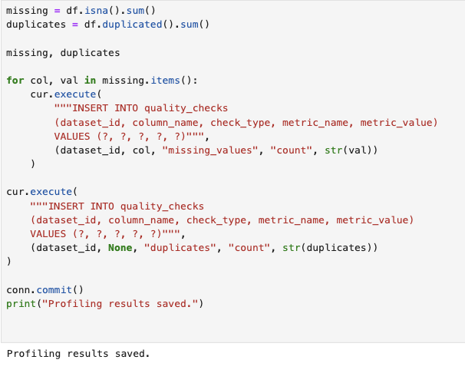
Profiling: Missing values and Duplicates
The segment computes missing values counts and duplicate rows, then stores those results into the quality_checks table. Profiling is essential because it reveals the structural issues in the dataset. In this case, the dataset has no missing values but contains duplicate rows, which will then allow the cleaning steps that follow.

Slide 6
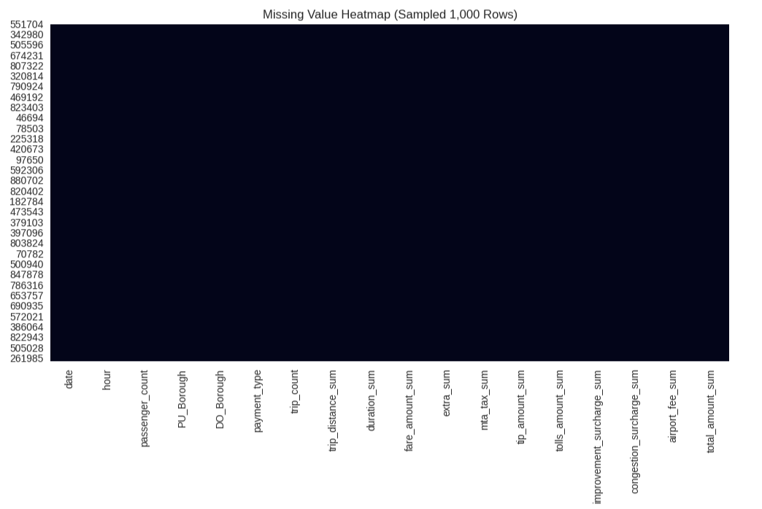
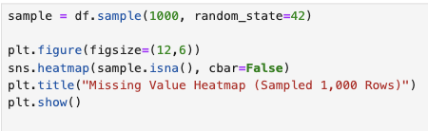
Missing Value Heatmap
A heatmap visualizing missing values on a 1,000-row sample confirms the profiling results. The heatmap appears as a solid block with no missing cells, indicating that the dataset is extremely clean in terms of completeness. This visualization is helpful because it provides a confirmation that no major structural gaps exist in the dataset.

Slide 7
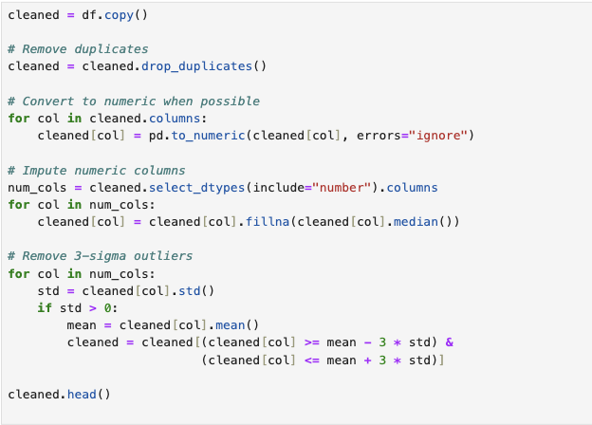
Data Cleaning Workflow
This cleaning stage normalizes the dataset by removing duplicate rows, converting columns to appropriate numeric types, and applying median imputation when its necessary. The system also filters out extreme outliers using the three-sigma rule to stabilize numeric distributions. These steps make the dataset more analytically reliable and enables the machine learning model to detect meaningful patterns instead of random noise.

Slide 8
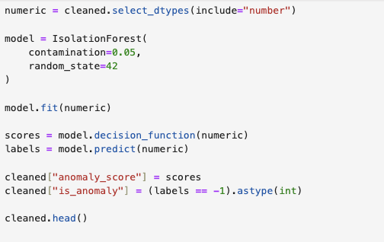
Isolation Forest Anomaly Detection
The model assigns an anomaly score to each row, where lower scores represent more isolated, atypical behavior. A binary label marks whether the observation is considered an anomaly. This basically introduces the machine learning aspect into the data quality pipeline, allowing automated detection of irregular trip metrics.

Slide 9
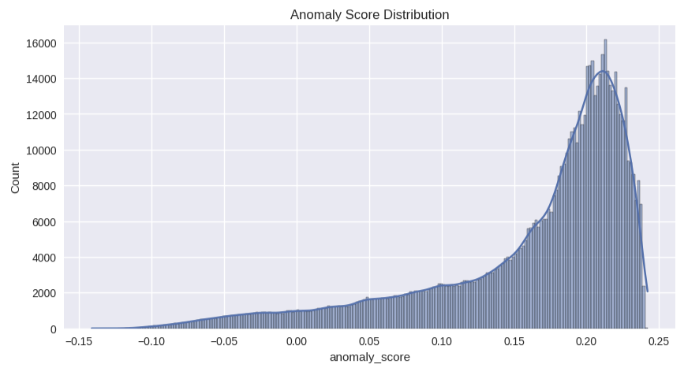
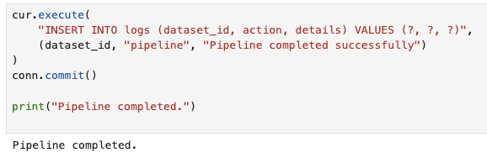
Anomaly Score Distribution & Pipeline
The anomaly score distribution visualization revels a concentrated region of normal observations and a long left tail or irregular entries. This demonstrates that although the dataset is structurally complete, there are still statistical anomalies worth looking in for. Finally, a completion log entry is inserted into the database to record that the pipeline ran successfully that rack workflow status for monitoring.

